Slide 1



Two dimensional topological models:
role of strain, disorder, stacking and twist
Marwa Mannaï

Slide 2




Motivation
Once upon time…
Anton Zeilinger
John F. Clauser
Alain Aspect
The Nobel physics laureates for 2022:
For pioneering work in quantum information
First quantum revolution
Second quantum revolution
time
1947
Transistor
2019
IBM Quantum computer
2

Slide 3

Motivation
Second quantum revolution
Quantum information
Quantum sensing
Quantum computing
Quantum communications
Quantum bit (qubit): building unit of quantum information
Requirements to build a qubit:
System with tunable states
States robust against environment changes (noise, disorder…)
How to build a qubit?
Quantum Information and Quantum Matter Conference, May 22-26, 2023
3

Slide 4
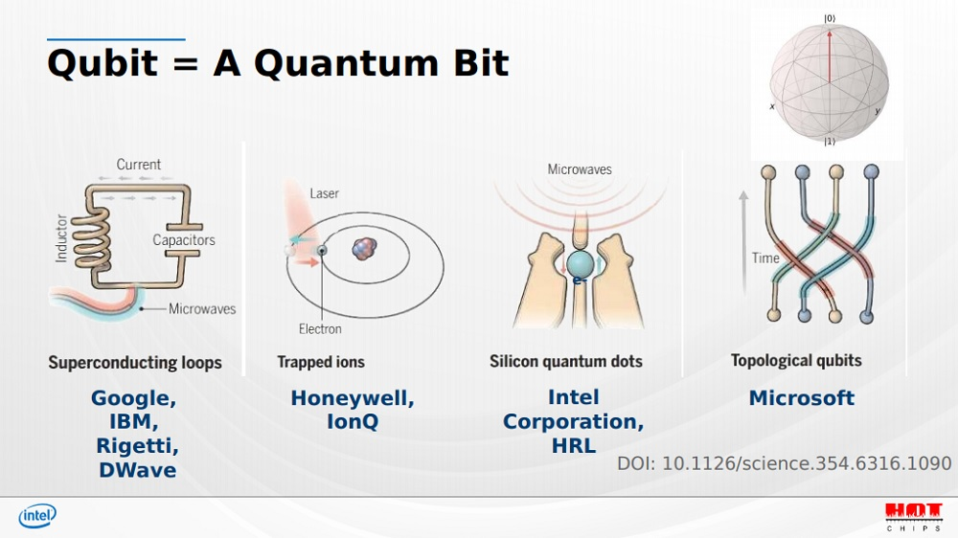
Motivation
Quantum Information and Quantum Matter Conference, May 22-26, 2023
5

Slide 5
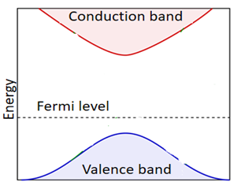
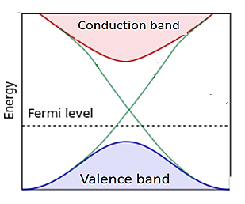
Motivation
Topological quantum materials
topologically protected states (robust against disorder)
Topology is a result of the system symmetries: Time reversal symmetry (TRS), Particle-hole symmetry,…
Example: Integer quantum Hall effect (IQHE)
Chiral edge states
B
insulator
Trivial insulator
Magnetic field breaks TRS
Bulk is an insulator
Conducting channels at the system boundaries: edge states
Counterpropagating edge states: Chiral edge states
chiral
edge states
Chern insulator: 2D insulator with chiral edge states
Chern insulator
6
Quantum Information and Quantum Matter Conference, May 22-26, 2023

Slide 6

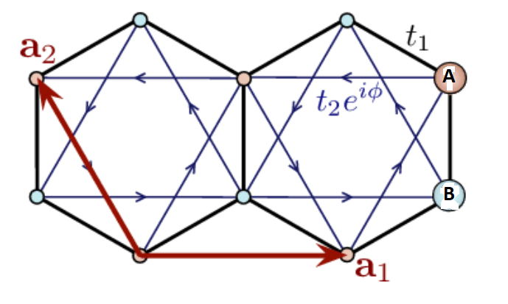
Motivation
Haldane model:
Haldane, Phys. Rev. Lett. 61, 2015 (1988)
Seminal paper of Topological Material
In life, there is something else besides magnetic field!
Haldane proposed IQHE without magnetic field!
Anomalous Quantum Hall effect (AQHE)
Honeycomb lattice (graphene-like) at zero magnetic filed with…
Broken Time Reversal Symmetry (TRS)
Complex second neighbor hopping parameters

Slide 7
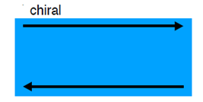
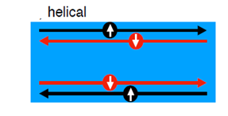
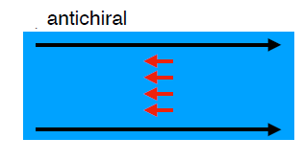
Motivation
Haldane model: extensions
Edge states: chiral, helical,… anti-chiral
Haldane model (1988) Chern insulator | Quantum spin Hall effect Spin-copies of the Haldane model Kane and Mele (2005) Topological insulator | Modified Haldane model Colomés and Franz, (2018) Semi-metal What about its topology?
broken TRS | invariant under TRS | broken TRS
Protected edge states | Protected edge states | Open question: Are antichiral edge states robust against disorder?
In my thesis: focus on the Haldane and the modified Haldane models

Slide 8
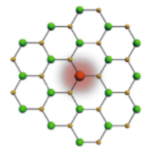
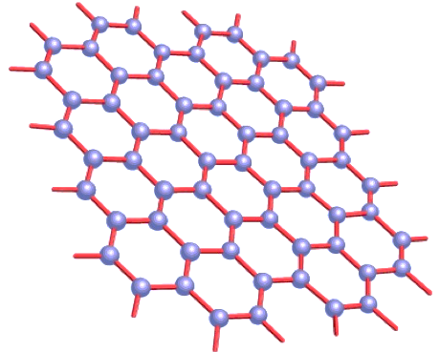
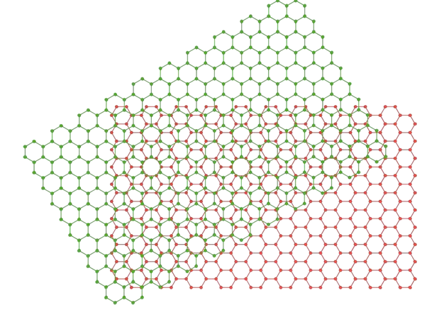
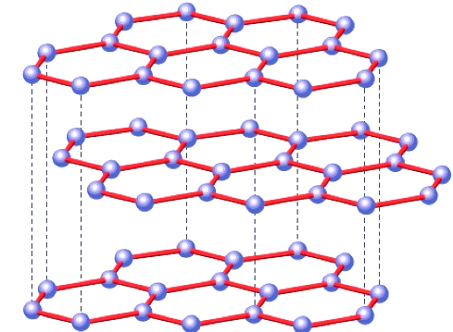
Motivation
Framework: graphene-like
Objective 1: probe the behavior of antichiral edge states under disorder
+ disorder = ?
Graphene with disorder
Objective 2: study the possibility to tune the chiral and anti-chiral edge states
State-of-the art: band structure of graphene is substantially modified under mechanical strain and by layer stacking or twisting
Strained graphene
Stacked graphene
Twisted bilayer graphene
Study the behavior of the chiral and antichiral edge states under strain, layer stacking and twisting (this thesis)
Combine strain, stacking and twist to tune the chiral and antichiral edge states (in progress)
Study the role of strain on the band structure of twisted bilayer graphene (this thesis)

Slide 9
Outline
Introduction:
Few words about graphene, Haldane and modified Haldane models
On the robustness of antichiral edges states
Haldane and modified Haldane models under strain
Bilayer modified Haldane: stacking versus topology
Interplay between strain and twist in twisted bilayer graphene (TBLG)
Summary & Outlooks

Slide 10
Outline
Introduction:
Few words about graphene, Haldane and modified Haldane models
On the robustness of antichiral edges states
Haldane and modified Haldane models under strain
Bilayer modified Haldane model: stacking versus topology
Interplay between strain and twist in twisted bilayer graphene (TBLG)
Summary & Outlooks

Slide 11
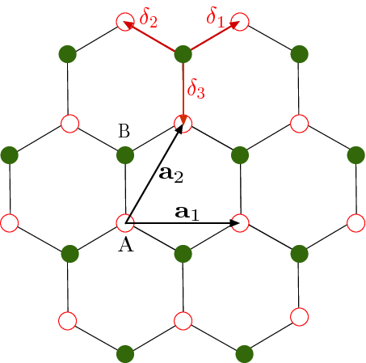
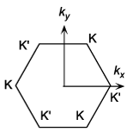
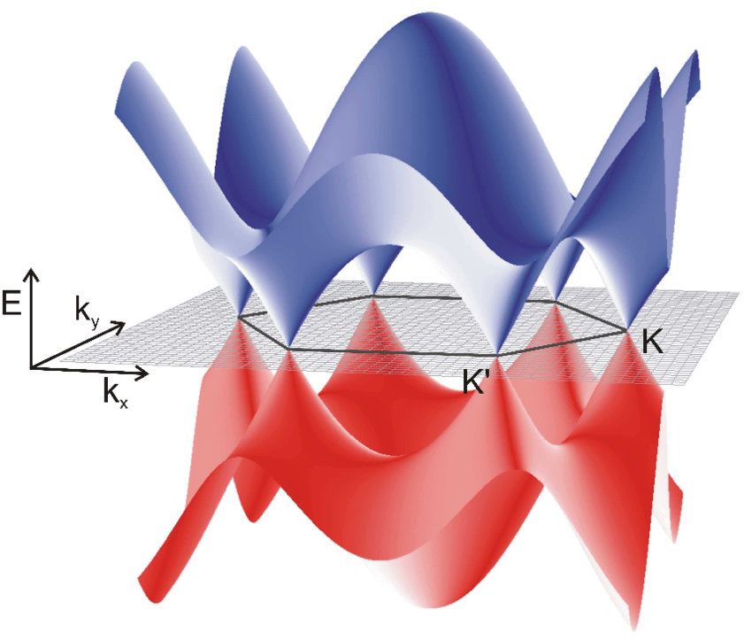




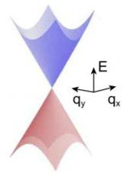



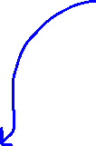
Introduction: Haldane and modified Haldane models
What is graphene?
Electronic properties of graphene
Tight binding Hamiltonian
around K and K’: massless Dirac Hamiltonian
Valley index
K and K’: Dirac points
11

Slide 12











Introduction: Haldane and modified Haldane models
Symmetry properties of graphene
: Pauli matrices
invariant under Time Reversal Symmetry TRS if
$\text{invariant} \text{under}$ Particle-hole symmetry if
$U_{C}:$ conjugation operator (electron hole)
$\text{invariant} \text{under}$ Chiral symmetry if
$U_{S}:$ chiral unitary operator
Graphene Hamiltonian is invariant under
TRS
Particle-hole symmetry
Chiral symmetry

Slide 13
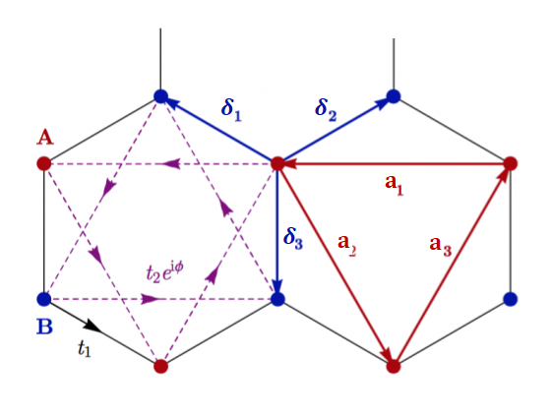





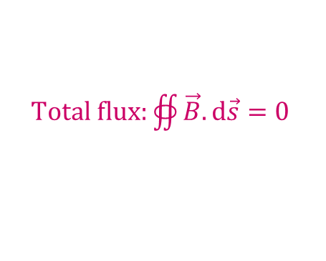
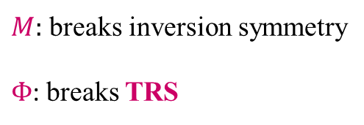
Introduction: Haldane and modified Haldane models
Haldane Hamiltonian
$$φ→\vec{A}→\vec{B}$$
Symmetries
$M:$ breaks inversion symmetry
$Φ$: breaks TRS
$Total flux:$ $∯{\vec{B}.ⅆ\vec{s}}=0$
TRS
Particle-hole symmetry
Chiral symmetry

Slide 14





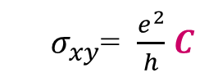

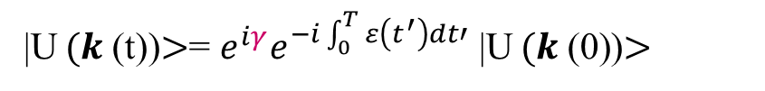
Introduction: Haldane and modified Haldane models
Hall conductivity of the Haldane model is quantized
${ σ}_{xy}$= $\frac{e^{2}}{h}$ $C$
Quantum Anomalous Hall effect (QAHE) ($\vec{B}$=$\vec{0})$
$C$is an integer Chern number
Chern number is a signature of the topological aspect of the wavefunction
Berry phase (1984)
Dynamical phase
Bloch function
|U$(k$(t))$>$= $e^{iγ}e^{−i\int_{0}^{T}{ε\left(t^{′}\right)dt′}}$ |U$(k \text{(}\text{0}\text{)}$)$>$
Berry phase
Michael Berry
Berry connection
Berry curvature
Chern number: Berry flux in the BZ

Slide 15
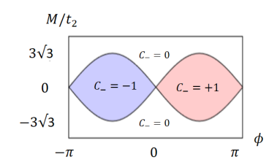
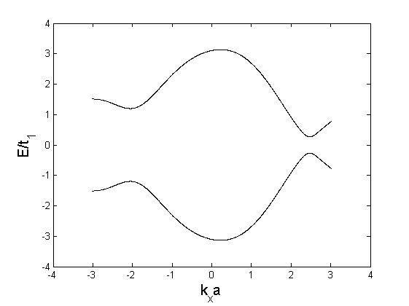
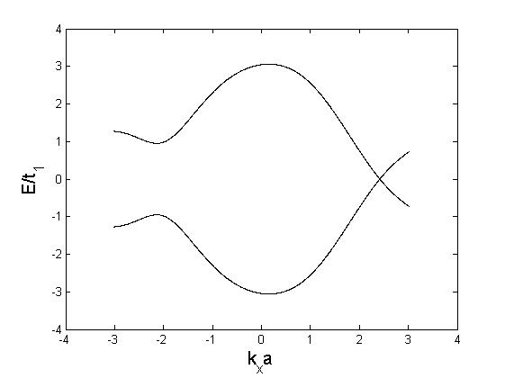
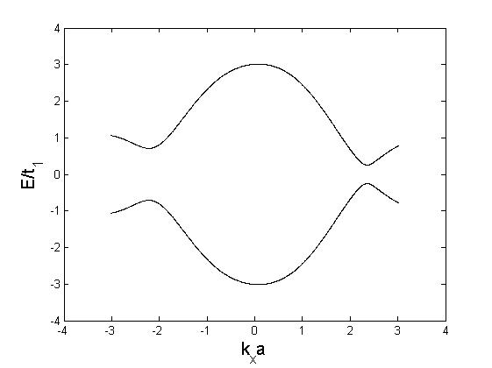
Introduction: Haldane and modified Haldane models
Topological Matter: phase is characterized by a topological invariant
Haldane phase diagram
Haldane, PRL (1988)
Band (trivial) insulator
Semi-metal
Topological insulator

Slide 16
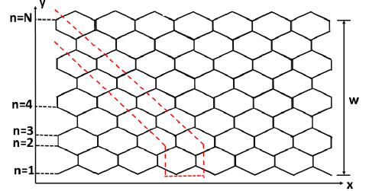
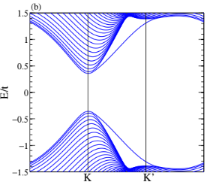
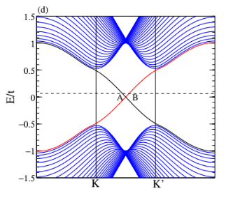
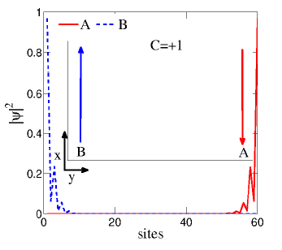
Introduction: Haldane and modified Haldane models
Bulk-edge correspondence
Haldane model on ribbon
Trivial phases
no edge states
Topological phases
Edge states

Slide 17
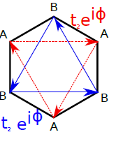






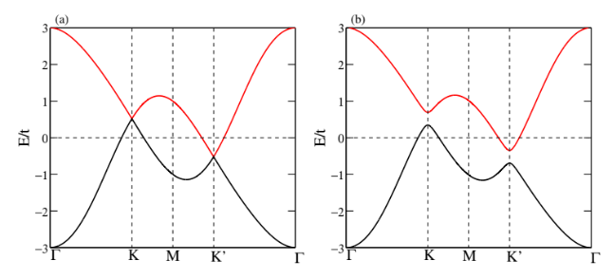
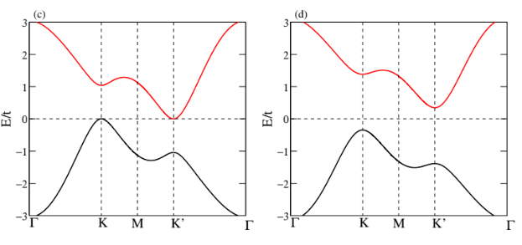
Introduction: Haldane and modified Haldane models
Modified Haldane model
Modified Haldane model
Haldane model
E. Colomés and M. Franz, Phys. Rev. Lett. 120, 086603 (2018)
Band structure
Modified Haldane model is a semi-metal if
What about the edge states?

Slide 18
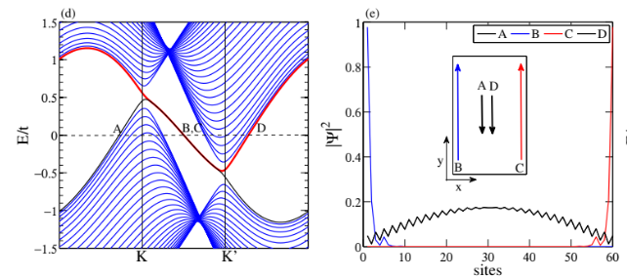
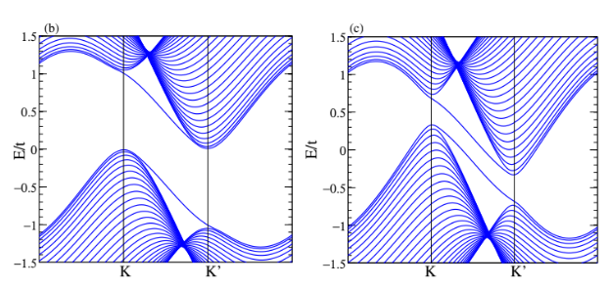
Introduction: Haldane and modified Haldane models
Modified Haldane model: Anti-chiral edge states
Modified Haldane model on zigzag ribbon

Slide 19
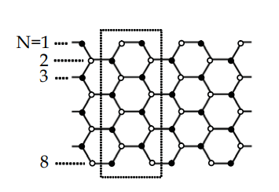
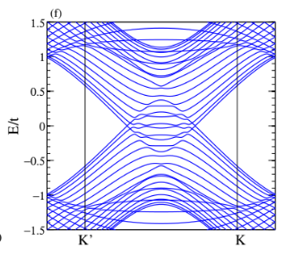
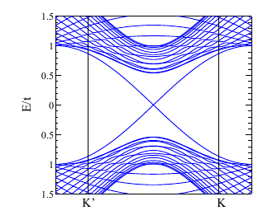
Introduction: Haldane and modified Haldane models
Modified Haldane model: Anti-chiral edge states
Modified Haldane model on armchair ribbon
Armchair ribbon
No anti-chiral edge states
Haldane model on armchair ribbon
chiral edge states
Antichiral edge states depend on the ribbon boundaries.
Question: Are they robust as chiral edge states?

Slide 20
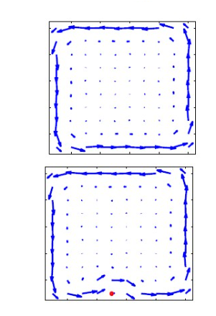
Introduction: Haldane and modified Haldane models
Robustness of chiral edge states against disorder
Disorder appears in different ways: Impurities, lattice distortions…
Disorder appears during synthesis, can be induced by doping…
Chiral edge states versus disorder
without disorder
with disorder
M. Hafezi et al., Nature Physics 7 (2011)
What about antichiral edge states?
Quantum Information and Quantum Matter Conference, May 22-26, 2023
20
Notes:
20

Slide 21
Outline
Introduction:
Few words about graphene, Haldane and modified Haldane models
On the robustness of antichiral edges states
Haldane and modified Haldane models under strain
Bilayer modified Haldane model: stacking versus topology
Interplay between strain and twist in twisted bilayer graphene (TBLG)
Summary & Outlooks

Slide 22
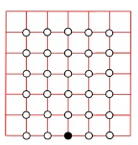
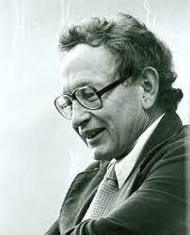


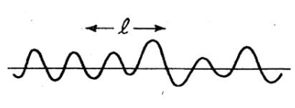
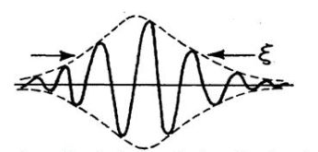





On the robustness of antichiral edges states
Introduction: Anderson Localization (1958)
Random onsite energies
P. W. Anderson
Nobel Prize 1977
Depending on the ratio $W/t$
W < $t$
W > $t$
Extended electronic wavefunction
over the mean free path l
Localized wave function
$ξ_{loc}$: Localization length
Quantum Information and Quantum Matter Conference, May 22-26, 2023
22
Notes:
22

Slide 23
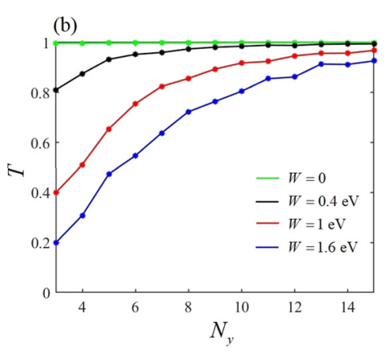
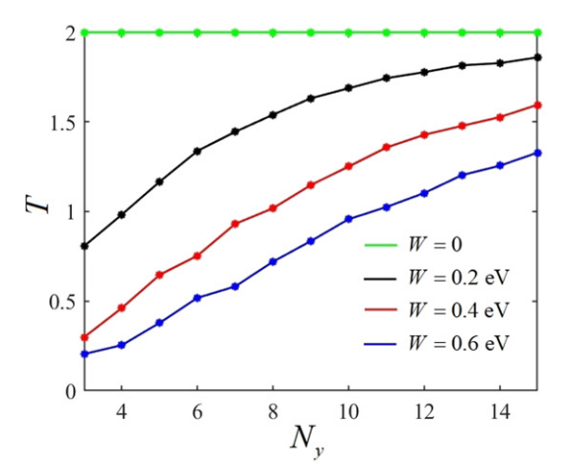
On the robustness of antichiral edges states
Modified Haldane model under Anderson disorder: State-of-the-art
Antichiral edge states
chiral edge states
Transmission coefficient
Transmission coefficient
Xiao-Long Lü et al., New J. Phys. 24 103021 (2022)
Transmission of chiral states is quantized even for strong disorder amplitude W
Transmission of antichiral edge states decreases with disorder W
Question:
How to characterize the robustness of antichiral edge states?

Slide 24
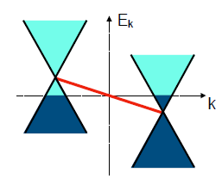
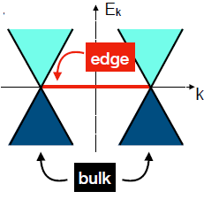


On the robustness of antichiral edges states
Modified Haldane model under Anderson disorder: State-of-the-art
Arguments for the robustness of antichiral edge states
Colomés and Franz, PRL (2018)
Antichiral edge states originate from the graphene zero-energy mode
Modified Haldane model
on a zigzag nanoribbon
Zigzag graphene nanoribbon
zero energy edge states are protected by the chiral symmetry
share the same topology with zigzag graphene nanoribbon
However, graphene (2D lattice) is not topological!
Question: How to characterize the topology of the antichiral edge states?
Answer: Mapping the lattice to 1D system and derive the corresponding topological invariant: winding number (Colomés and Franz)

Slide 25
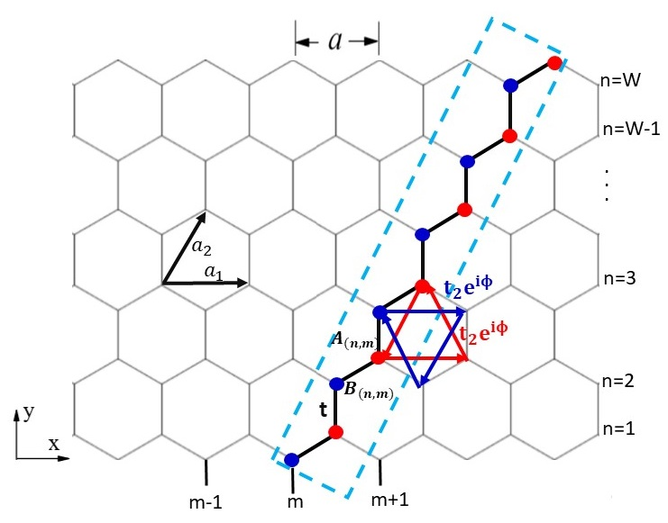

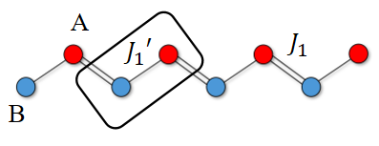



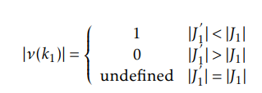
On the robustness of antichiral edges states
Mapping to 1D topological insulator
Modified Haldane model on zigzag ribbon
Colomés and Franz, PRL (2018)
1D extended Su-Schrieffer-Heeger (SSH) model
Winding number
Topological insulator
Trivial insulator

Slide 26
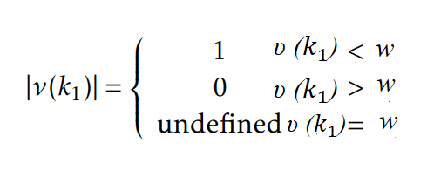




On the robustness of antichiral edges states
Mapping to 1D topological insulator
Colomés and Franz, PRL (2018)
Zero-energy modes are localized at the chain edges
Antichiral edge states are also described by a winding number at 1D
How this winding number behaves under disorder?

Slide 27



On the robustness of antichiral edges states
Our work
Compute the winding number of a 1D reduced modified Haldane model in the presence of disorder
Determine numerically the localization length of the antichiral edge states based on the transfer matrix method applied to the 2D modified Haldane model
Numerical approach
random onsite energy
Equal disorder: the impurities are randomly distributed on A and B sublattices
E. V. Castro et al., Phys. Rev. B 92, 085410 (2015)
Numerical methods in real space:
Coupling matrix to derive the winding number
Transfer Matrix method to derive the localization length

Slide 28



On the robustness of antichiral edges states
1D reduced modified Haldane model
Results:
E. V. Castro et al., Phys. Rev. B 92, 085410 (2015)
Modified Haldane model
Haldane model
$<$ν$>$ decreases rapidly with disorder
The decrease of $<$ν$>$is slightly dependent on the disorder density
W/t
C is robust against weak disorder W < 4t
C decreases to zero for strong disorder
Antichiral edge states are less robust than the chiral ones
Robust topological phase

Slide 29




On the robustness of antichiral edges states
Localization length in 2D: Transfer Matrix Method
Localized state: if ${\text{Λ}}_{M_{y}}$ decreases for large $M_{y}$
Extended state: if ${\text{Λ}}_{M_{y}}$ increases/does not change for large $M_{y}$
$M_{y}$: system size
$n_{I}$=1, $t_{2}$=0.2t, ϕ=$\frac{π}{3}$, W=5t, t is NN hopping integral
Haldane model
Modified Haldane model
Extended states
No extended states

Slide 30
On the robustness of antichiral edges states
Take home messages I
Topological invariant of the 1D reduced modified Haldane model is rapidly suppressed by disorder
At strong disorder, the modified Haldane model edge states are Anderson localized.
Localization lengths showed that the edge states of the modified Haldane model are more localized by disorder than those of the Haldane model
Antichiral edge states are not robust against disorder as chiral edge states

Slide 31


On the robustness of antichiral edges states
Edge states depend on the electronic band structure
Graphene electronic band structure modified by mechanical strain
Questions:
Could chiral and antichiral edges states be tuned by a mechanical strain?
Could strain induce topological phase transition in the Haldane and modified Haldane models?

Slide 32
Outline
Introduction:
Few words about graphene, Haldane and modified Haldane models
On the robustness of antichiral edges states
Haldane and modified Haldane models under strain
Bilayer modified Haldane model: stacking versus topology
Interplay between strain and twist in twisted bilayer graphene (TBLG)
Summary & Outlooks

Slide 33


Haldane and modified Haldane models under strain
State-of-the-art
Question: what happens under uniform strain?

Slide 34










Haldane and modified Haldane models under strain
Lattice parameter under uniform strain
Armchair Strain
$ε=\frac{δa}{a}$ strain amplitude
Hopping parameters
Complex phases
Without strain
With strain
Anisotropy velocities
Tilt parameter
Valley dependent mass term
Valley index

Slide 35







Haldane and modified Haldane models under strain
Haldane model under uniaxial strain: ribbon geometry
Results:
$ε$= 0
$ε$= 0.1
$ε$= 0.15

Slide 36







Haldane and modified Haldane models under strain
Modified Haldane model under uniaxial strain: continuum limit
Without strain
With strain
Valley dependent energy shift
$ε$= -0.08
$ε$= 0
$ε$= 0.1
$ε$= 0.15
Question: How to realize experimentally such edge state tuning?

Slide 37





Haldane and modified Haldane models under strain
Experimental reaization of strain tuned chiral and antichiral edge states
Haldane, PRL (1988)
First realization of the Haldane model: artificial lattices (optical lattices of cold atoms)
Esslinger group, Nature 515, 237 (2014)
Realization of the Haldane model in solid states
37

Slide 38


Haldane and modified Haldane models under strain
Realization of the modified Haldane model in solid states (proposal)
Hole doped or electron-doped 2D metal transition dichalcogenide material WSe₂
Colomés and Franz, PRL 120, 086603 (2018)
Realization of the modified Haldane model in artificial lattices

Slide 39
Haldane and modified Haldane models under strain
Take home messages II
Haldane model
    topological phase can be turned into a trivial one.
    transitions between phases, with different Chern numbers
    dispersion of the topologically protected edge states in the Haldane model could be modified by the strain.
Modified Haldane model
Strain could switch the direction of the antichiral edge current
Uniform uniaxial strain could tune the topology of the Haldane model and the dispersion of the chiral and antichiral edge states
M. Mannai and S. Haddad, J. Phys.: Condens. Matter 32, 225501 (2019)

Slide 40

Haldane and modified Haldane models under strain
Besides strain, there are other parameters to tune the electronic properties of 2D materials: Layer stacking
Question:
How chiral and antichiral edges states behave by stacking two layers described by the Haldane and the modified Haldane models?

Slide 41
Outline
Introduction:
Few words about graphene, Haldane and modified Haldane models
On the robustness of antichiral edges states
Haldane and modified Haldane models under strain
Bilayer modified Haldane model: stacking versus topology
Interplay between strain and twist in twisted bilayer graphene (TBLG)
Summary & Outlooks

Slide 42



Bilayer modified Haldane model: stacking versus topology
Graphene and its heterostructures

Slide 43




Bilayer modified Haldane model: stacking versus topology
Graphene and its heterostructures
AA stacking
AB stacking
AB bilayer has two Fermi points with parabolic band structure
AA-stacked graphene bilayer is a metal
with Dirac cone band structure
Sboychakov et al. PRB 2016

Slide 44







Bilayer modified Haldane model: stacking versus topology
State of-the-art
Haldane model in AA stacked bilayer
S. Bhattacharjee et al, Phys. Rev. B 103, 224304 (2021)
= $±2$ if $C_{1}=C_{2}$
Bilayer Chern insulator $C_{tot}$=$C_{1}$+$C_{2}$
= $±$1 if $C_{1}=$ $±$1 and $C_{2}$=0
= 0 if $C_{1}=−C_{2}$
Topological phase is independent of the stacking type (AA/AB) and the nature of the ribbon (ZZ/AmC).
Quantum Information and Quantum Matter Conference, May 22-26, 2023
44
Notes:
44

Slide 45




Bilayer modified Haldane model: stacking versus topology
What about two stacked layers of modified Haldane model (semi-metal)?
$C_{1}$= $∅$
$C_{2}$= $∅$

Slide 46




Bilayer modified Haldane model: stacking versus topology
AB bilayer modified Haldane model with opposite complex phases
Bloch Hamiltonian
Breaks TRS
Breaks particle-hole symmetry
Breaks chiral symmetry

Slide 47








Bilayer modified Haldane model: stacking versus topology
AB bilayer modified Haldane model with opposite complex phases
Electronic band structure
$a_{k}$= 0
Quadratic point (AB Bilayer)
$∆$= 0
$t_{⊥}$= 0
Nodal lines
gapped insulator
Nodal lines
System is gapped by the interlayer hopping which lifts the degeneracy of the nodal lines and opens a gap

Slide 48





Bilayer modified Haldane model: stacking versus topology
AB bilayer modified Haldane model with opposite complex phases
Chern number
For $t_{2}≪t_{⊥ }$: Two-band effective Hamiltonian
Quadratic contact point of the AB bilayer graphene + Mass term
Chern number
Valley index of the quadratic point
Valley index
C= $±$2
AB stacking of two semi-metals with opposite signs of the complex phases ($ϕ_{1}ϕ_{2}$< 0) becomes a Chern insulator under the interlayer coupling
Stacking-induced Chern insulator
What about the corresponding edge states?

Slide 49






Bilayer modified Haldane model: stacking versus topology
AB bilayer modified Haldane model on zigzag nanoribbon

Slide 50

Bilayer modified Haldane model: stacking versus topology
AB bilayer modified Haldane model on an armchair nanoribbon
Modified Haldane model in a monolayer armchair ribbon
Two chiral edges modes even in the absence of antichiral edge states in the armchair monolayer modified Haldane model
Could the chiral edge states emerge in AA bilayer modified Haldane model?

Slide 51

Bilayer modified Haldane model: stacking versus topology
AA bilayer modified Haldane model
Zigzag
Armchair
No chiral edge states
System remains gapless under the interlayer coupling C = $∅$
Fermi surface of the AA bilayer modified Haldane model are stable against the interlayer hopping

Slide 52




Bilayer modified Haldane model: stacking versus topology
Schematic interpretation of the stacking-dependent chirality
AB stacking
AA stacking
AB stacking: $A_{1}$ and $B_{2}$ with clockwise chirality
BA stacking: $B_{1}$ and $A_{2}$ with anti-clockwise chirality
AA stacking: same sublattices with opposite fluxes
Dominant chirality
No dominant chirality

Slide 53




Bilayer modified Haldane model: stacking versus topology
Experimental realization
Hole doped/electron-doped 2D metal transition dichalcogenide material (WSe₂)
Colomés and Franz, PRL 120, 086603 (2018)

Slide 54
Bilayer modified Haldane model: stacking versus topology
Take home message III
Topological phase of these models can be effectively manipulated by the stacking order:
    Chern insulating phases in the AB (BA) bilayer with a Chern number C = ±2 (C = ∓2).
    Gapless state in the AA stacked bilayer
Chern number C of the gapped phases results from the instability of the Fermi line against the interlayer coupling.
Pair of chiral edge states appears at the boundaries of the bilayer ribbons the AB bilayer ribbons, regardless of the boundary nature (zigzag/armchair) of the ribbons
Interlayer coupling induces a Chern insulator in the AB bilayer modified Haldane model with complex phases of opposite signs
M. Mannai, J. -N. Fuchs, F. Piéchon and S. Haddad, Phys. Rev. B 107, 045117 (2023)

Slide 55


Bilayer modified Haldane model: stacking versus topology
Twisting layers as a second degree of freedom in graphene-based structures
No rotation in Lego !
Questions
What is the behavior of the Chern phase induced in the AB stacked bilayers of Haldane and modified Haldane models if the layers are twisted?
Since strain could tune the chiral and antichiral edge states, what is the interplay between twist and strain in twisted bilayer graphene?

Slide 56
Outline
Introduction:
Few words about graphene, Haldane and modified Haldane models
On the robustness of antichiral edges states
Haldane and modified Haldane models under strain
Bilayer modified Haldane: stacking versus topology
Interplay between strain and twist in twisted bilayer graphene (TBLG)
Summary & Outlooks
56

Slide 57


Interplay between strain and twist in twisted bilayer graphene
TBLG: moiré structure
Moiré patterns: superlattice structures that appear when two crystals with a lattice mismatch or with a different orientation are superimposed
Commensurability condition
R: rotation matrix with angle θ

Slide 58





Interplay between strain and twist in twisted bilayer graphene (TBLG)
TBLG: moiré structure
$L_{m}$ ~10 nm (${10}^{4}$ atoms/moiré unit cell)
Moiré Brillouin zone
Moon & Koshino, PRB 90 155406 (2015)

Slide 59



Interplay between strain and twist in twisted bilayer graphene (TBLG)
TBLG: band structure
ϴ=0.5°
B. Chittari/University of Seoul, South Korea
Flat band at the so-called Magic angle $Θ_{m}$=1.05°
Localized DOS with peaks at AA stacked regions

Slide 60




Interplay between strain and twist in twisted bilayer graphene
TBLG: continuum model
Flat band: theoretical predication
Fourier transform of the hopping amplitudes can be truncated to three hopping processes around Dirac points
Bistritzer and MacDonald, PNAS 108, 12233 (2011)
Continuum model
Interlayer coupling terms
Layer 1
Layer 2

Slide 61




Interplay between strain and twist in twisted bilayer graphene (TBLG)
TBLG: continuum model
Bistritzer and MacDonald, PNAS 108, 12233 (2011)
Flat band: theoretical predication
Perturbative approach: effective Hamiltonian to leading order in k.
Renormalized velocity
$$∝\frac{1}{θ}$$
Bistritzer & MacDonald defined Magic angle as the angle where the Fermi velocity at Dirac point vanishes
$$v^{∗}\left(α\right)=0$$
$$v^{∗}=0 for α^{2}=\frac{1}{3} θ≡θ_{m}=1°.05$$
so-called Magic Angle (first MA)

Slide 62



Interplay between strain and twist in twisted bilayer graphene (TBLG)
TBLG: phase diagram
Consequences of flat band
Cao, Y., et al. Nature 556, 43–50 (2018)
Cao, Y., et al. Nature 556, 43–50 (2018)
Sidis, Comptes Rendus Physique (2007)
62

Slide 63






Interplay between strain and twist in twisted bilayer graphene (TBLG)
TBLG: hot topic!

Slide 64


Interplay between strain and twist in twisted bilayer graphene (TBLG)
TBLG under strain
Numerical calculations based on continuum model
(Bistritzer McDonald 2011)
Our motivation

Slide 65


Interplay between strain and twist in twisted bilayer graphene
Bistritzer and MacDonald + uniform heterostrain ?

Slide 66

Interplay between strain and twist in twisted bilayer graphene (TBLG)
TBLG under strain: continuum model
Monolayer graphene rotated by an angle $θ$ under a uniform strain
where
,
valley index
Total deformation tensor
strain tensor
small-angle rotation matrix
position of the Dirac points
Dirac point of the undeformed layer
effective gauge field
$β\sim 3$for graphene, $a$ is the lattice parameter

Slide 67





Interplay between strain and twist in twisted bilayer graphene (TBLG)
TBLG under strain: continuum model
Heterostrain
Layers 1 and 2 are rotated and strained oppositely
to preserve the orientation of the moiré Brillouin zone
Bistritzer and MacDonald approach
D. E. Parker et al. Phys. Rev. Lett. 127, 027601 (2021).
Bi et al. PRB 100, 035448 (2019)

Slide 68



Interplay between strain and twist in twisted bilayer graphene (TBLG)
TBLG under strain: continuum model
Bistritzer and MacDonald approach
Renormalized Dirac velocities
Flatness of the low-energy bands can be selectively tuned by the strain along the moiré BZ directions by choosing, for a given twist angle $θ$, the strain value at which the corresponding effective velocity vanishes

Slide 69



Interplay between strain and twist in twisted bilayer graphene (TBLG)
TBLG under strain: continuum model
Analytical and numerical results
Numerics
Analytical

Slide 70




Interplay between strain and twist in twisted bilayer graphene (TBLG)
TBLG under strain: continuum model
Comparison with existing data
Bi et al., PRB 100, 035448 (2019)
Our analytical and numerical results: uniaxial strain
$θ_{m}^{exp}=1.05°$
For a uniaxial strain of $ε=0.6\%$ applied along the direction ϕ = 30◦, corrections to the Dirac velocities reach $±0.13v_{F}$.

Slide 71
Interplay between strain and twist in twisted bilayer graphene (TBLG)
Take home message IV
Derive low-energy Hamiltonian of TBLG under a mechanical strain
Strain can be tuned to flatten the lowest-energy bands in TBLG
Analytical expressions to explain the interplay between strain and twist and to control the flatness of the moiré bands
Flat bands in TBLG are substantially dependent on strain
M. Mannai. and S. Haddad, Phys. Rev. B 103, L201112 (2021)

Slide 72
Outline
Introduction:
Few words about graphene, Haldane and modified Haldane models
On the robustness of antichiral edges states
Haldane and modified Haldane models under strain
Bilayer modified Haldane: stacking versus topology
Interplay between strain and twist in twisted bilayer graphene (TBLG)
Summary & Outlooks

Slide 73
Summary
Antichiral edge modes are less robust against disorder compared to the chiral ones
Topology of the Haldane model could be tuned by the strain:
    topological phase can be turned into a trivial one
    transitions between phases, with different Chern numbers
Dispersion of the chiral and antichiral edge could be modified by the strain.
    AB stacking of two modified Haldane model with oppositely breaking TRS drives the system into a Chern insulator with C=2.
Two chiral channels emerge at the ribbon boundaries (zigzag/armchiar).
Mechanical strain is a key parameter to tune the flatness of the low energy bands of TBLG

Slide 74







What should be next…
Topology in TBLG: Haldane model in TBLG
Continuum limit
$t_{2}$=0.1t, $θ$=1.08°
${\text{ϕ}}_{1}={\text{ϕ}}_{2}$ = $\frac{π}{2}$, ${\text{M}}_{1}={\text{M}}_{2}=0$
${\text{ϕ}}_{1}={\text{ϕ}}_{2}$ = $\frac{π}{2}$, ${\text{M}}_{1}={\text{M}}_{2}=\text{3}\sqrt{3}t_{2}$
${\text{ϕ}}_{1}\text{=} \frac{π}{2}, {\text{ϕ}}_{2}$ = 0, ${\text{M}}_{1}=\text{3}\sqrt{3}t_{2}, {\text{M}}_{2}=0$
Flat band survives
Flat band + Dirac cone

Slide 75




What should be next…
Topology in TBLG
Haldane model in TBLG nanoribbon
Modified Haldane model
in TBLG nanoribbon
$t_{2}$=0.1t, $θ$=1.08°
${\text{ϕ}}_{1}={\text{ϕ}}_{2}$ = $\frac{π}{2}$, ${\text{M}}_{1}={\text{M}}_{2}=0$
${\text{ϕ}}_{1}={\text{− }\text{ϕ}}_{2}$ = $\frac{π}{2}$, ${\text{M}}_{1}={\text{M}}_{2}=0$
Pair of chiral edge states
G. Trambly de Laissardière

Slide 76





Many thanks to
Collaborators
Sonia Haddad
Faculty of Sciences of Tunis,
(Supervisor)
Eduardo V. Castro
Faculty of Sciences of Porto,
Portugal
Jean-Noël FUCHS
Paris-Jussieu University
(and Orsay group)
Thank you for your attention
Frédéric Piéchon
Paris-Saclay University
(Orsay group)
Guy Trambly
de Laissardière
Paris-Cergy University

Slide 78
Interplay between strain and twist in twisted bilayer graphene (TBLG)
TBLG: understand the emergence of flat bands
Cao et al. Nature (2018)
Left: Large twist angle, no interlayer hybridization.
Middle: Large twist angle, hybridization energy w much smaller than the height of crossing.
Right: Small twist angle, hybridization energy comparable to crossing height, band fattens.

Slide 79







Interplay between strain and twist in twisted bilayer graphene (TBLG)
TBLG: experimental realization
tear-and-stack fabrication method
after, P. Herrero’s talk
Kim, K. et al. Nano Lett. 16, 1989-1995 (2016)
Cao, Y. et al. Phys. Rev. Lett. 117, 116804 (2016)

