Slide 1
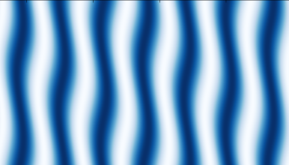

Dynamical Symmetry Breaking
in Optically Driven 2D Materials
Netanel Lindner
NYUAD May2023

Slide 2
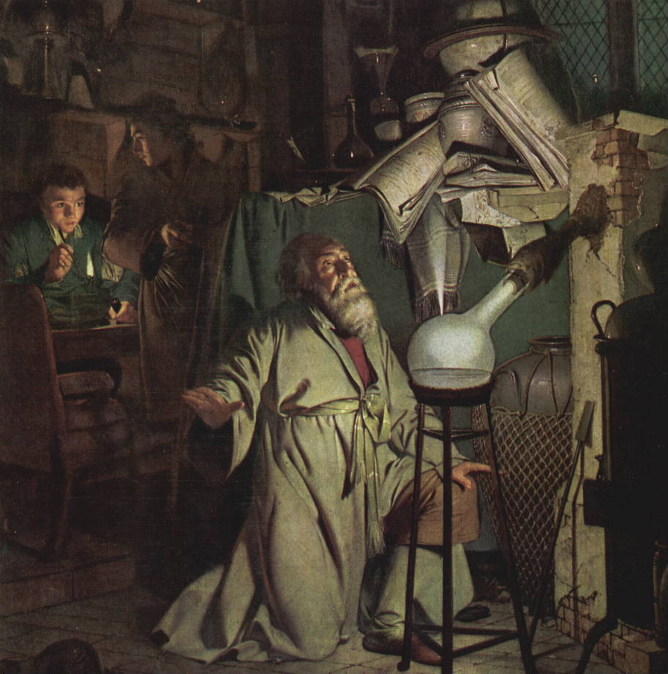
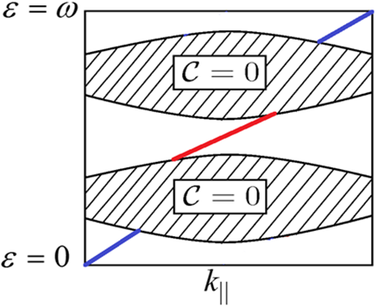
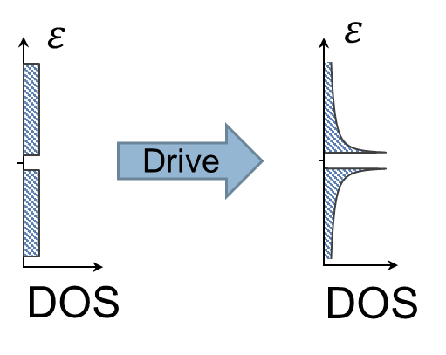
Floquet engineering of bandstructures
Topological properties
Geometric properties

Slide 3
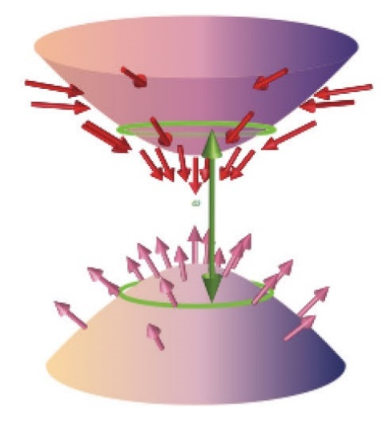
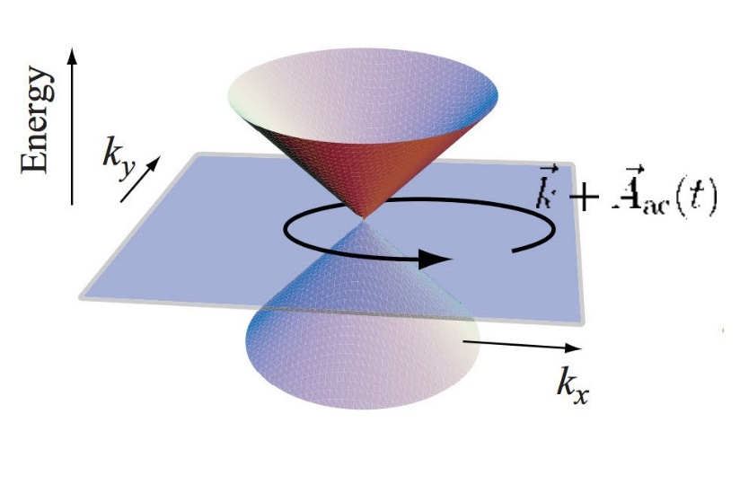
Dynamical control of electronic bandstructures
Circularily polarized light opens a Haldane gap in graphene
Resonant driving used to open a Floquet gap and create a band-inversion
T. Oka and H. Aoki, PRB 79, 081406 (2009)
NL, V. Galitski, G. Refael, Nat. Phys. 7 409 (2011)

Slide 4
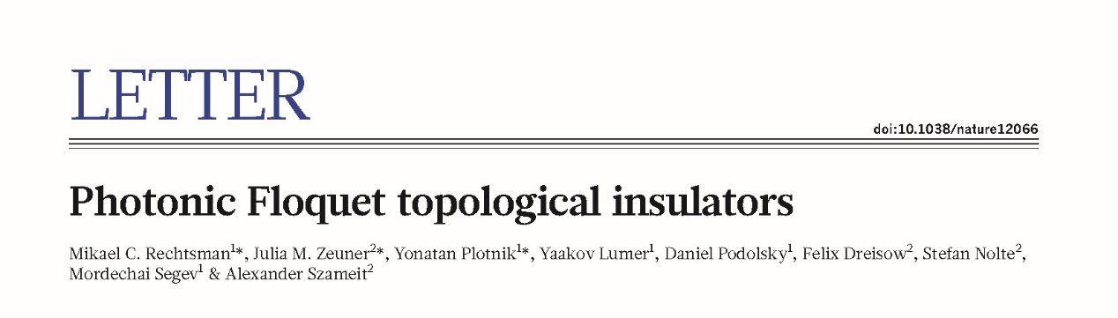
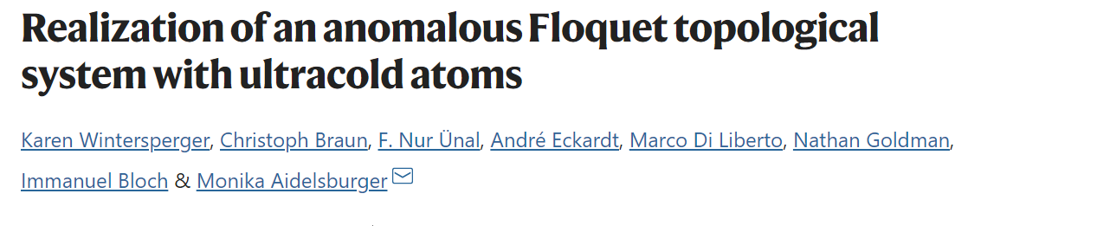
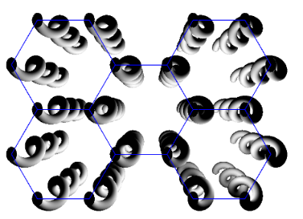
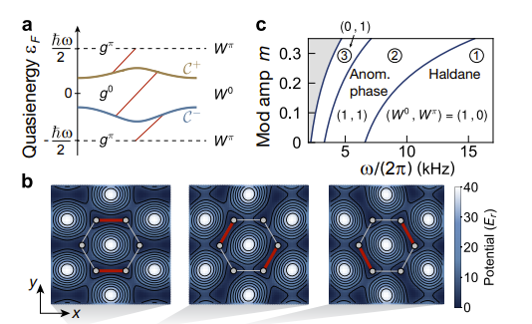
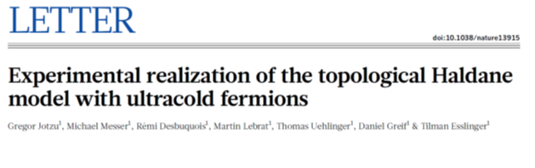
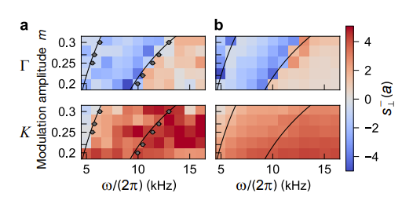
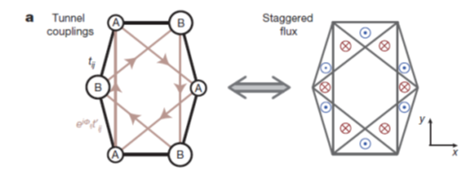
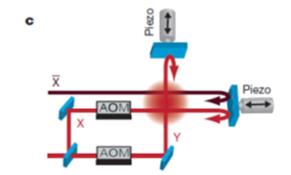
Experiments – AMO

Slide 5
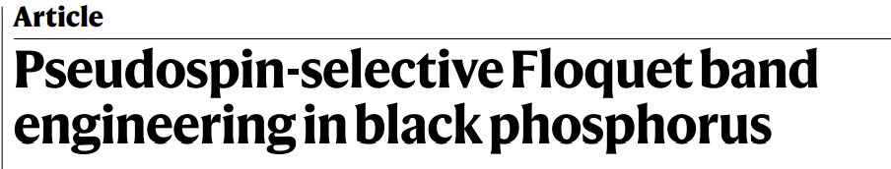
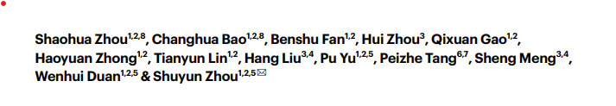
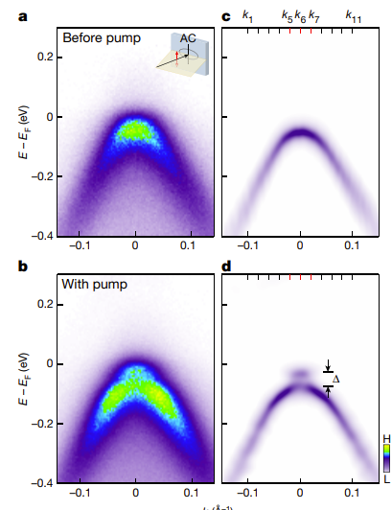
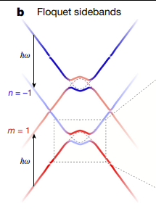
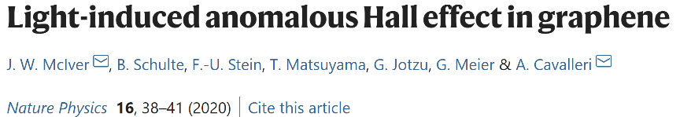
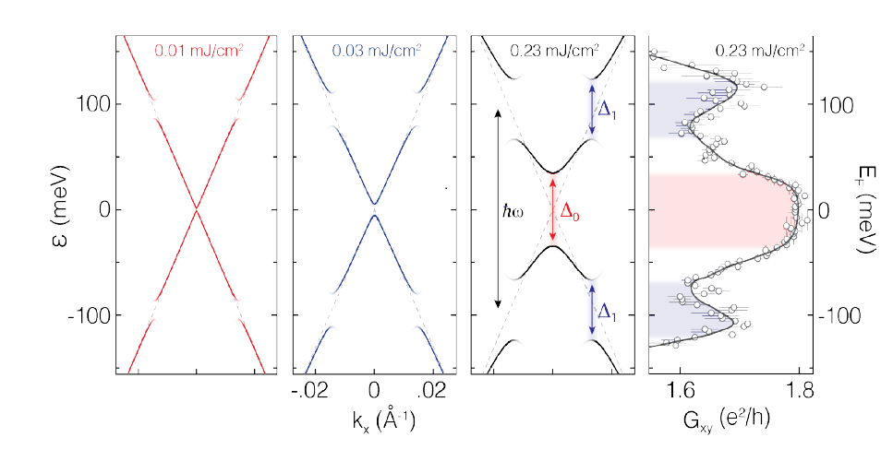
Experiments - solid state

Slide 6
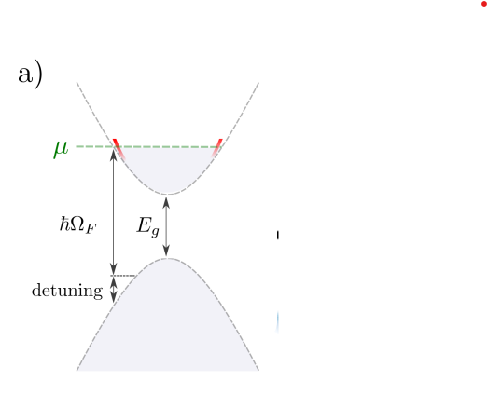
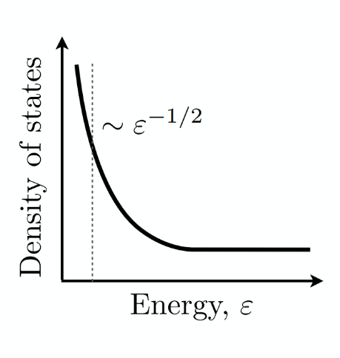
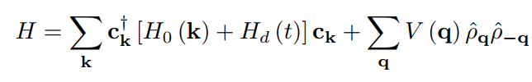
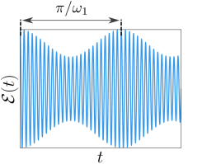

From Floquet band engineering to symmetry breaking
Diverging density of states
near resonance circle
Periodic Modulation
of the Fermi velocity

Slide 7
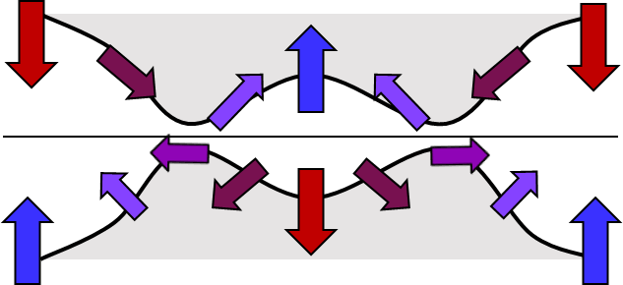
Floquet engineering a band inversion

Slide 8
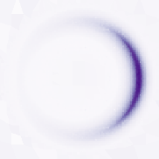
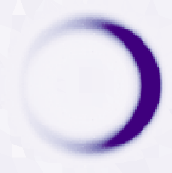
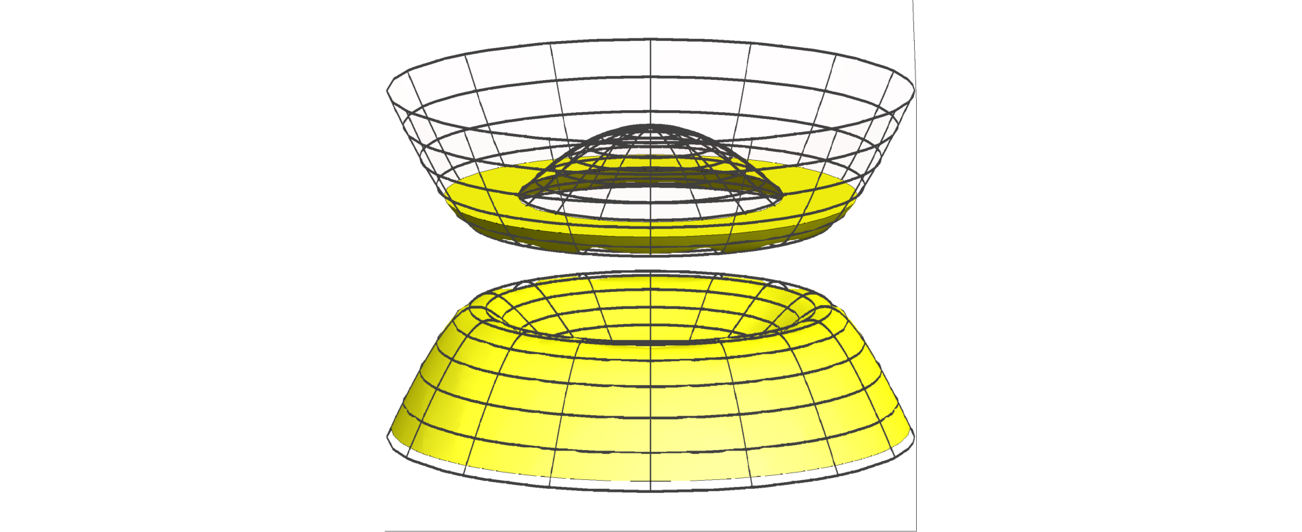
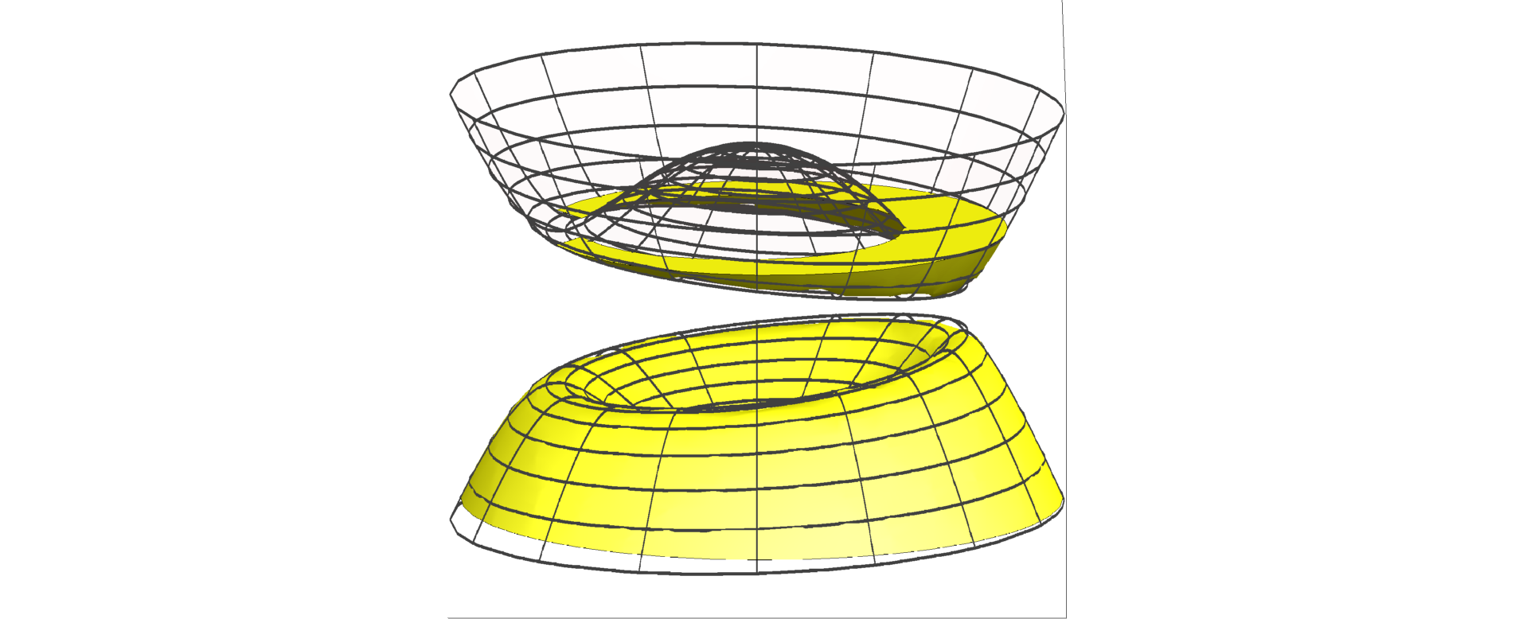

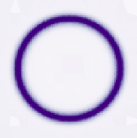










Gyro-ferromagnetic nematic phase
Diverging density of Floquet states instability of the Fermi surface near half filling
1
Without EE interactions:
Symmetric phase
With contact EE interactions:
Broken-symmetry phase
10⁻³
$${\overline{f}}_{k−}$$
$$f_{k+}$$
10⁻⁶
holes
electrons
Interaction strength
$${−log}_{10}({|h}_{1}^{\left(xy\right)}|/Δ_{F}){ }$$
$${\overline{f}}_{k−}$$
$$f_{k+}$$
holes
electrons
$$k_{y}$$
$$k_{y}$$
Normalized doping
$$D(ε)$$
$$ε$$
$$k_{x}$$
$$k_{x}$$
Esin, Gupta, Berg, Rudner, NL, Nat. Comm. 12, 5299 (2021)

Slide 9













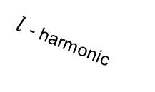

Oscillating ferromagnetic order parameter
Symmetric
$×$10⁻³
$${|h}_{l}^{(α)}|/U$$
$$y$$
$$z$$
$$x$$
$$0°$$
$l$ - harmonic
$$270°$$
$$90°$$
Broken symmetry
$$180°$$
$$k_{y}$$
$×$10⁻³
$${|h}_{l}^{(α)}|/U$$
$$k_{x}$$
$$z$$
$$x$$
$$y$$
$$h_{α}\left(t\right)=\sum_{l}{h_{l}^{\left(α\right)}e^{iωt}}$$
$$H_{MF}\left(k,t\right)=H_{0}\left(k\right)+H_{drive}\left(t\right)+h\left(t\right)⋅σ$$
Esin, Gupta, Berg, Rudner, NL, Nat. Comm. 12, 5299 (2021)

Slide 10
Oscillating ferromagnetic order parameter
Symmetric
$×$10⁻³
$${|h}_{l}^{(α)}|/U$$
$$y$$
$$z$$
$$x$$
$$0°$$
$l$ - harmonic
$$270°$$
$$90°$$
Broken symmetry
$$180°$$
$$k_{y}$$
$×$10⁻³
$${|h}_{l}^{(α)}|/U$$
$$k_{x}$$
$$z$$
$$x$$
$$y$$
$$h_{α}\left(t\right)=\sum_{l}{h_{l}^{\left(α\right)}e^{iωt}}$$
$$H_{MF}\left(k,t\right)=H_{0}\left(k\right)+H_{drive}\left(t\right)+h\left(t\right)⋅σ$$
Esin, Gupta, Berg, Rudner, NL, Nat. Comm. 12, 5299 (2021)

Slide 11
Floquet band engineering to symmetry breaking
Diverging density of states
near resonance circle
Periodic Modulation
of the Fermi velocity

Slide 12





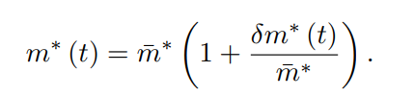

Modulated Floquet Parametric Driving
Kiselev, Rudner, NL, arXiv:2303.02148
Drive Hamiltonian
Drive detuning blocks single photon absorption
Drive-induced change to the Fermi velocity
Slow modulation of the drive amplitude:
Fixed (charge conservation), change in

Slide 13
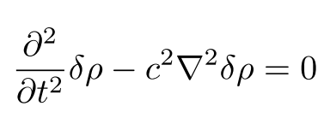
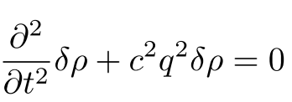

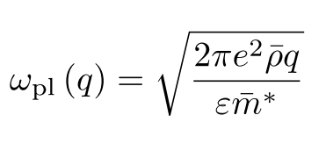
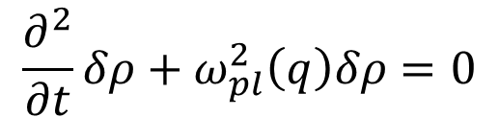
Plasmons
- Propagating electron density fluctuations
- analogy: sound in neutral gas:
- charged 2D electron gas:
$$\frac{∂^{2}}{∂t}δρ+ω_{pl}^{2}\left(q\right)δρ=0$$

Slide 14




Modulated Floquet Parametric Driving
Hydrodynamic description for the electrons
Continuity equation for charge:
Continuity equation for momentum (Euler eq.):
Energy momentum tensor
Energy-momentum
Damping
Electrostatic potential

Slide 15

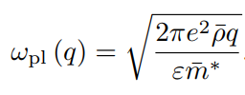
Modulated Floquet Parametric Driving
Hydrodynamic equation for electron density:
Linear stability analysis:
Equilibrium
Plasmon
Dispersion

Slide 16
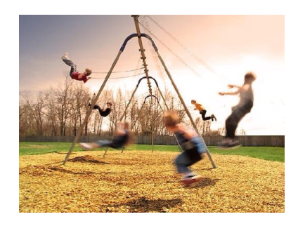
Modulated Floquet Parametric Driving
Hydrodynamic equation for electron density:
Linear stability analysis:
Equilibrium
Plasmon
Dispersion
Kiselev, Rudner, NL
arXiv:2303.02148

Slide 17
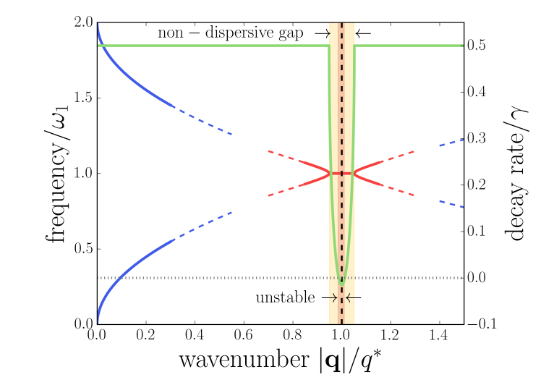



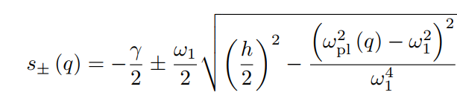



Modulated Floquet Parametric Driving
Drive-induced Plasmon dispersion
Fastest growing modes:
$$ε_{pl}\left(q\right)=ω_{1}±is\left(q\right)$$
Instability:
Kiselev, Rudner, NL, arXiv:2303.02148
$$h>2γ/ω_{1}$$

Slide 18
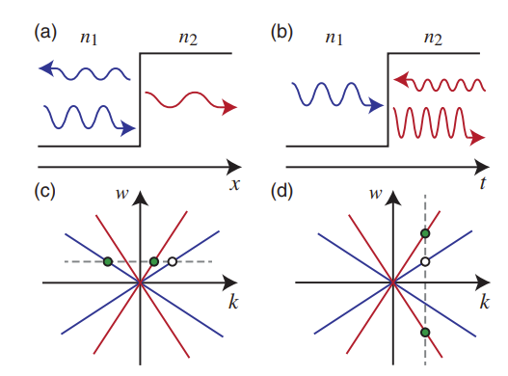
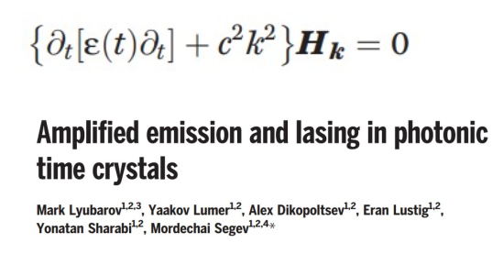
Analogy to time-varying photonic media
Time-modulation of the permittivity
Science 377 425 (2022)
Gallifi et. al. Advanced Photonics (2022)

Slide 19
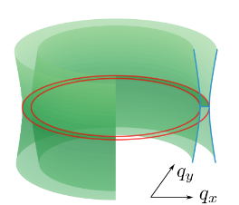

Instability and pattern formation
Drive-induced Plasmon dispersion
$$ε_{pl}\left(q\right)=ω_{1}±is\left(q\right)$$
Fastest growing modes:
Instability:
$$h>2γ/ω_{1}$$

Slide 20
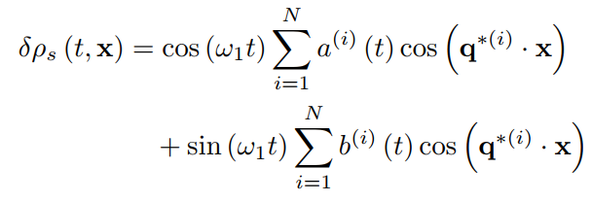






Instability and spontaneous pattern formation
Steady state beyond the instability:
$$±q_{2}^{∗}$$
$$±q_{1}^{∗}$$
Continuity equation and
Longitudinal plasmons:
Project equation of motion on unstable modes
Keep only Only 3rd order nonlinearities:

Slide 21
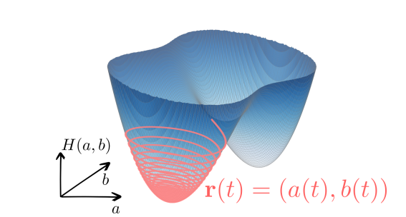
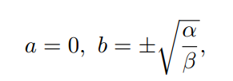





Crystallization
Steady state beyond the instability:
Hamiltonian for equation of motion for a,b: coefficients:
Minimum at:
$$Γ_{N}=2N−1$$

Slide 22
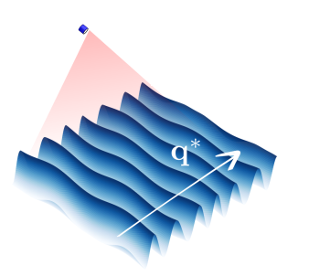
Crystallization
Steady state beyond the instability:
Hamiltonian for equation of motion for a,b coefficients:
Minimum at:

Slide 23
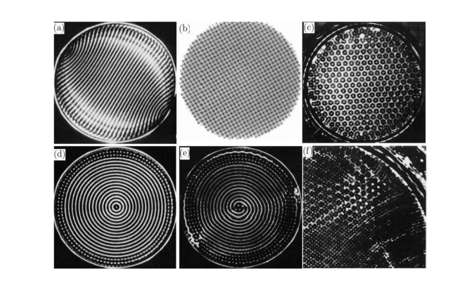
Crystallization
Steady state beyond the instability:
Spontaneous symmetry breaking of translational and rotational symmetries
Plasmonic crystal
Faraday waves in Liquids

Slide 24
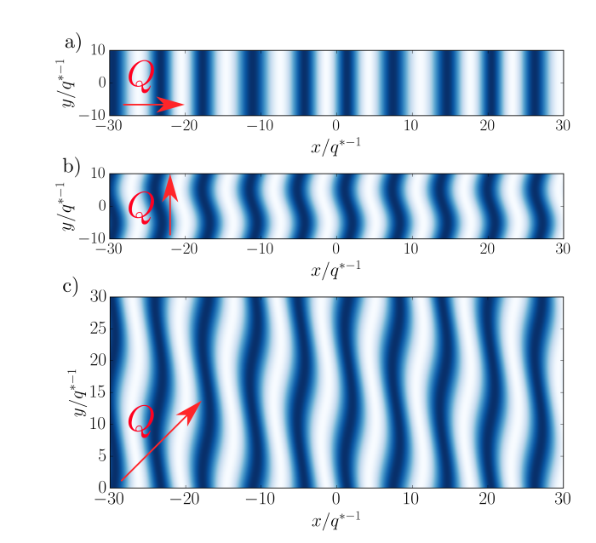
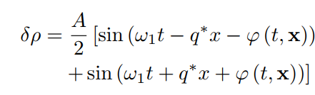


Goldstone modes in the steady state
Steady state of driven 2D materials can spontaneously breaks symmetry. Can we observe goldstone modes?
Slow fluctuations above the steady state:
Dispersion of eigenmodes of :

Slide 25








Acknowledgments
Egor Kiselev
Iliya Esin
Mark Rudner
Erez Berg
Gaurav Gupta

Slide 26

Summary
Steady states with spontaneously broken symmetry induced by optical driving.
Modulated Floquet Parametric Driving (MFPD):
  Control of low frequency collective modes using high-frequency, modulated optical signals
MFPD of plasmons:
  Nontrivial propagation of plasmons (akin to time-varying photonic media)
  Suppressed photon absorption and heating rates
  Attainable with relatively low-power drive
Esin, Gupta, Berg, Rudner, NL, Nat. Comm. 12, 5299 (2021)
Kiselev, Rudner, NL, arXiv:2303.02148
Thank you.

